Slide 1
Reinforcement Learning --Models and Practice
Hanbo Xie

Slide 2
Content
Introduction and Brief History
Models and Simulations
Extensions
Bayesian Reinforcement Learning Model(Optional)

Slide 3
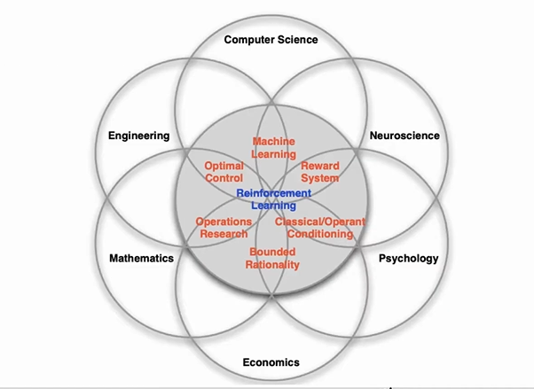
Introduction
Reinforcement Learning is far more complex than we imagine!

Slide 4
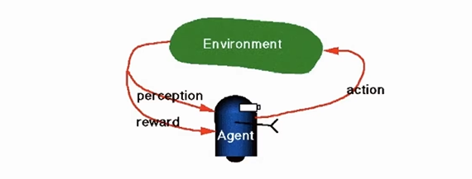
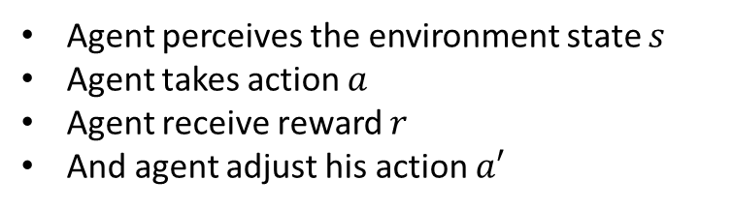
Introduction
Agent perceives the environment state $s$
Agent takes action $a$
Agent receive reward $r$
And agent adjust his action $a′$

Slide 5
Brief History
Edward Thorndike’s experiment with cats escaping from puzzle boxes. (Thorndike E (June 1898). "Some Experiments on Animal Intelligence". Science. 7 (181): 818–24. )
B.F. Skinner, who published his seminal work on the topic in The Behavior of Organisms, in 1938, and elaborated this research in many subsequent publications. (Skinner, B. F. "The Behavior of Organisms: An Experimental Analysis", 1938 New York: Appleton-Century-Crofts)
Sutton, Barto, Reinforcement Learning: An introduction.(1998)

Slide 6
Upcoming Scientists
Michael. J. Frank, Yael Niv, Tim Beherns, Nathanial Daw, Read Montague, Peter Dayan, Dayeol Lee……
RL has been expanded from non-social context to social context.

Slide 7
A little bit difference in RL
Reinforcement Learning in Computer Science (e.g. AI):
Optimal control
Planning
Reinforcement Learning in Psychology/Behavioral Science:
Conditioning
Human/animal based mechanisms

Slide 8

RL in AI
Perceive the state board
Act legally
Play against itself
Rewarded by the result
Invent new policy to play
AlphaGo

Slide 9


Scenario
Restaurant A
Restaurant B

Slide 10
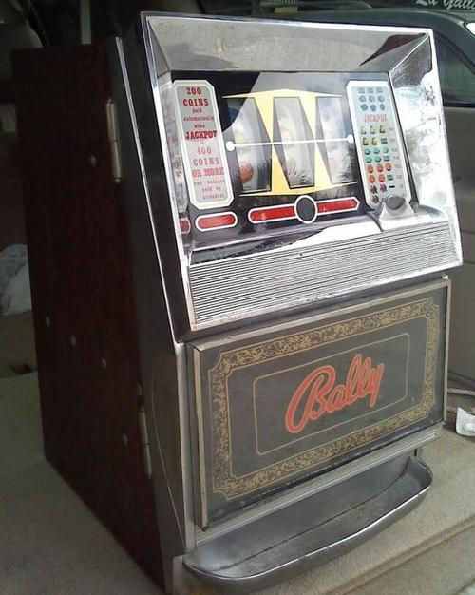
Bandit Task
?
B
A
P(reward)=0.8
P(reward)=0.2

Slide 11
Model-Free Learning
Win-Stay-Loss-Switch strategy:
stay at the same choice when win and switch to others when lose.
Reward driven.
No inference on hidden states.

Slide 12


Step-by-Step Simulation
1.Define the environment
3.Define the environment response
4.Set and run the simulation process!
2. Define (an) agent(s)
Action(choice)
Reward(feedback)
Policy (strategy)
Hidden States…
for-loop: trials and agents
5.Analyze and visualize your simulated data!

Slide 13
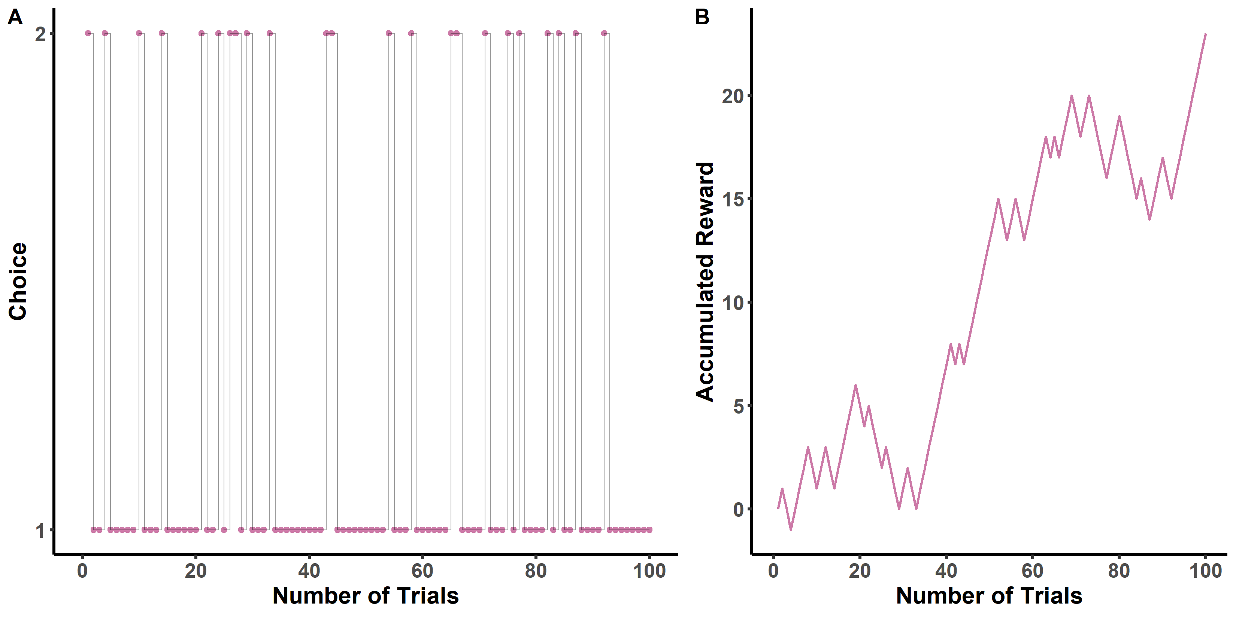
Result(WSLS)

Slide 14



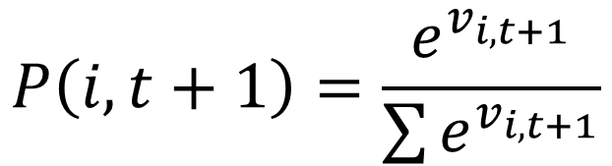
Rescorla-Wagner Model
$$PE=R−v_{i,t}$$
Prediction Error
$$v_{i,t+1}=v_{i,t}+α∗PE$$
$α$:learning rate
$$P\left(i,t+1\right)=\frac{e^{v_{i,t+1}}}{\sum{e^{v_{i,t+1}}}}$$
Softmax function
Rescorla, R. A., & Wagner, A. R. (1972)

Slide 15
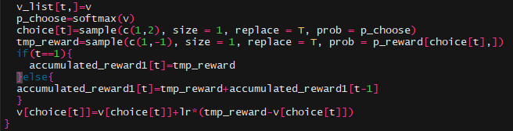
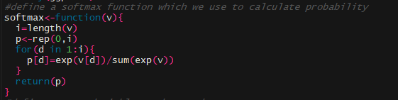
Implementation
Simulation Process
Softmax function wrap up

Slide 16
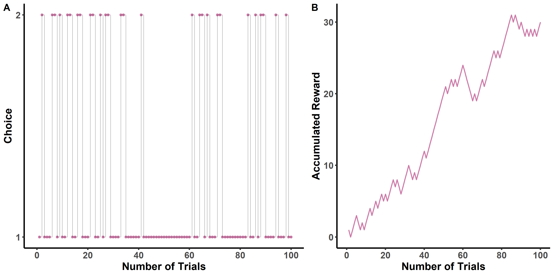
Results(RW model)

Slide 17
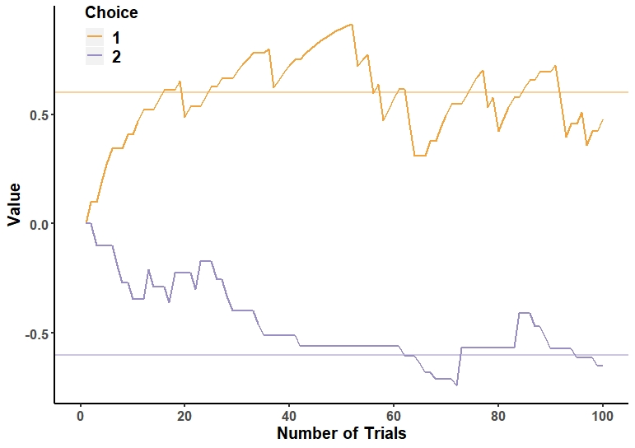
Results(RW model)

Slide 18
Interactive Demo(RW model)
Learning rate can only reveal how fast, or how reliably that the agent learns from the last reward.
Higher learning rate can quickly learn about the value, while lower learning rate can better adapt uncertainty.
L Zhang, L Lengersdorff, N Mikus, J Gläscher, C Lamm - 2019

Slide 19
Short Summary
To simulate, you need to:
Define the environment
Define an agent
Define the environment response
Set and run simulation process
Analyze and visualize simulated data
Some Tips:
Wrap up your functions and models
Store your variables by vectors, matrices, arrays and lists instead of single variable
Use scaling when necessary(when producing Inf, -Inf, NaN values)
Use Parallel Computing when faced with large-scale simulation task.

Slide 20
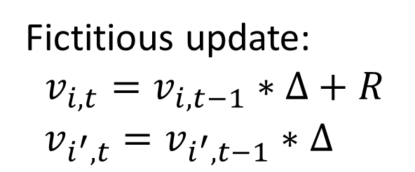
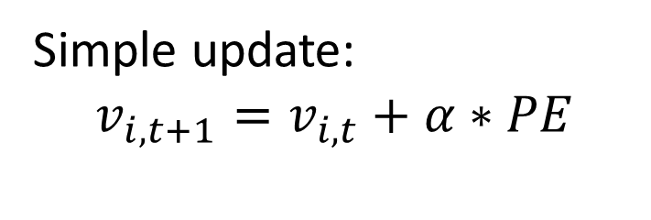
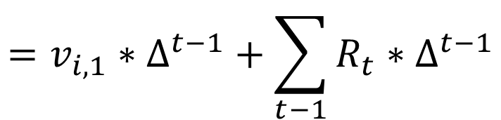

Decay rule
Simple update:
$$v_{i,t+1}=v_{i,t}+α∗PE$$
Fictitious update:
$$v_{i,t}=v_{i,t−1}∗∆+R$$
$v_{i^{′},t}=v_{i^{′},t−1}∗∆$
$$∆:decay factor$$
$$v_{i,t}={(v}_{i,t−2}∗∆+R_{t−2})∗∆+R_{t−1}$$
$$=v_{i,1}∗∆^{t−1}+\sum_{t−1}{R_{t}∗∆^{t−1}}$$
TD Learning
Erev, I., & Roth, A. E. (1998).

Slide 21
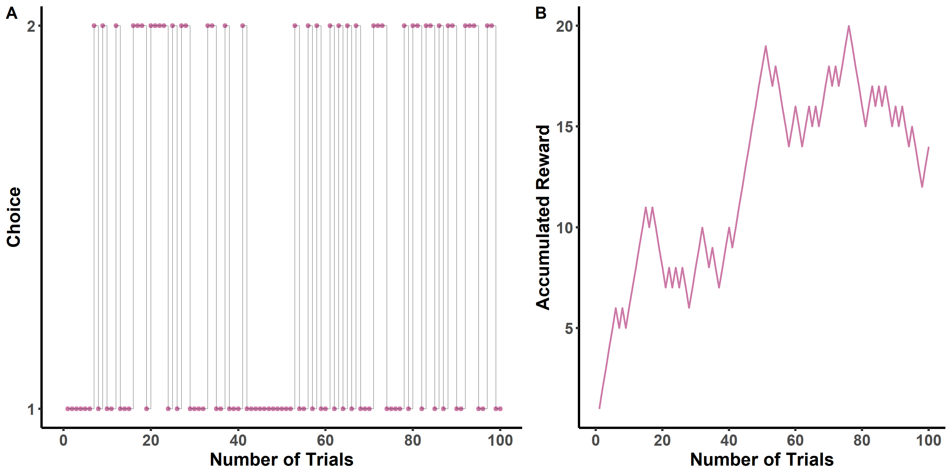
Results(decay)

Slide 22
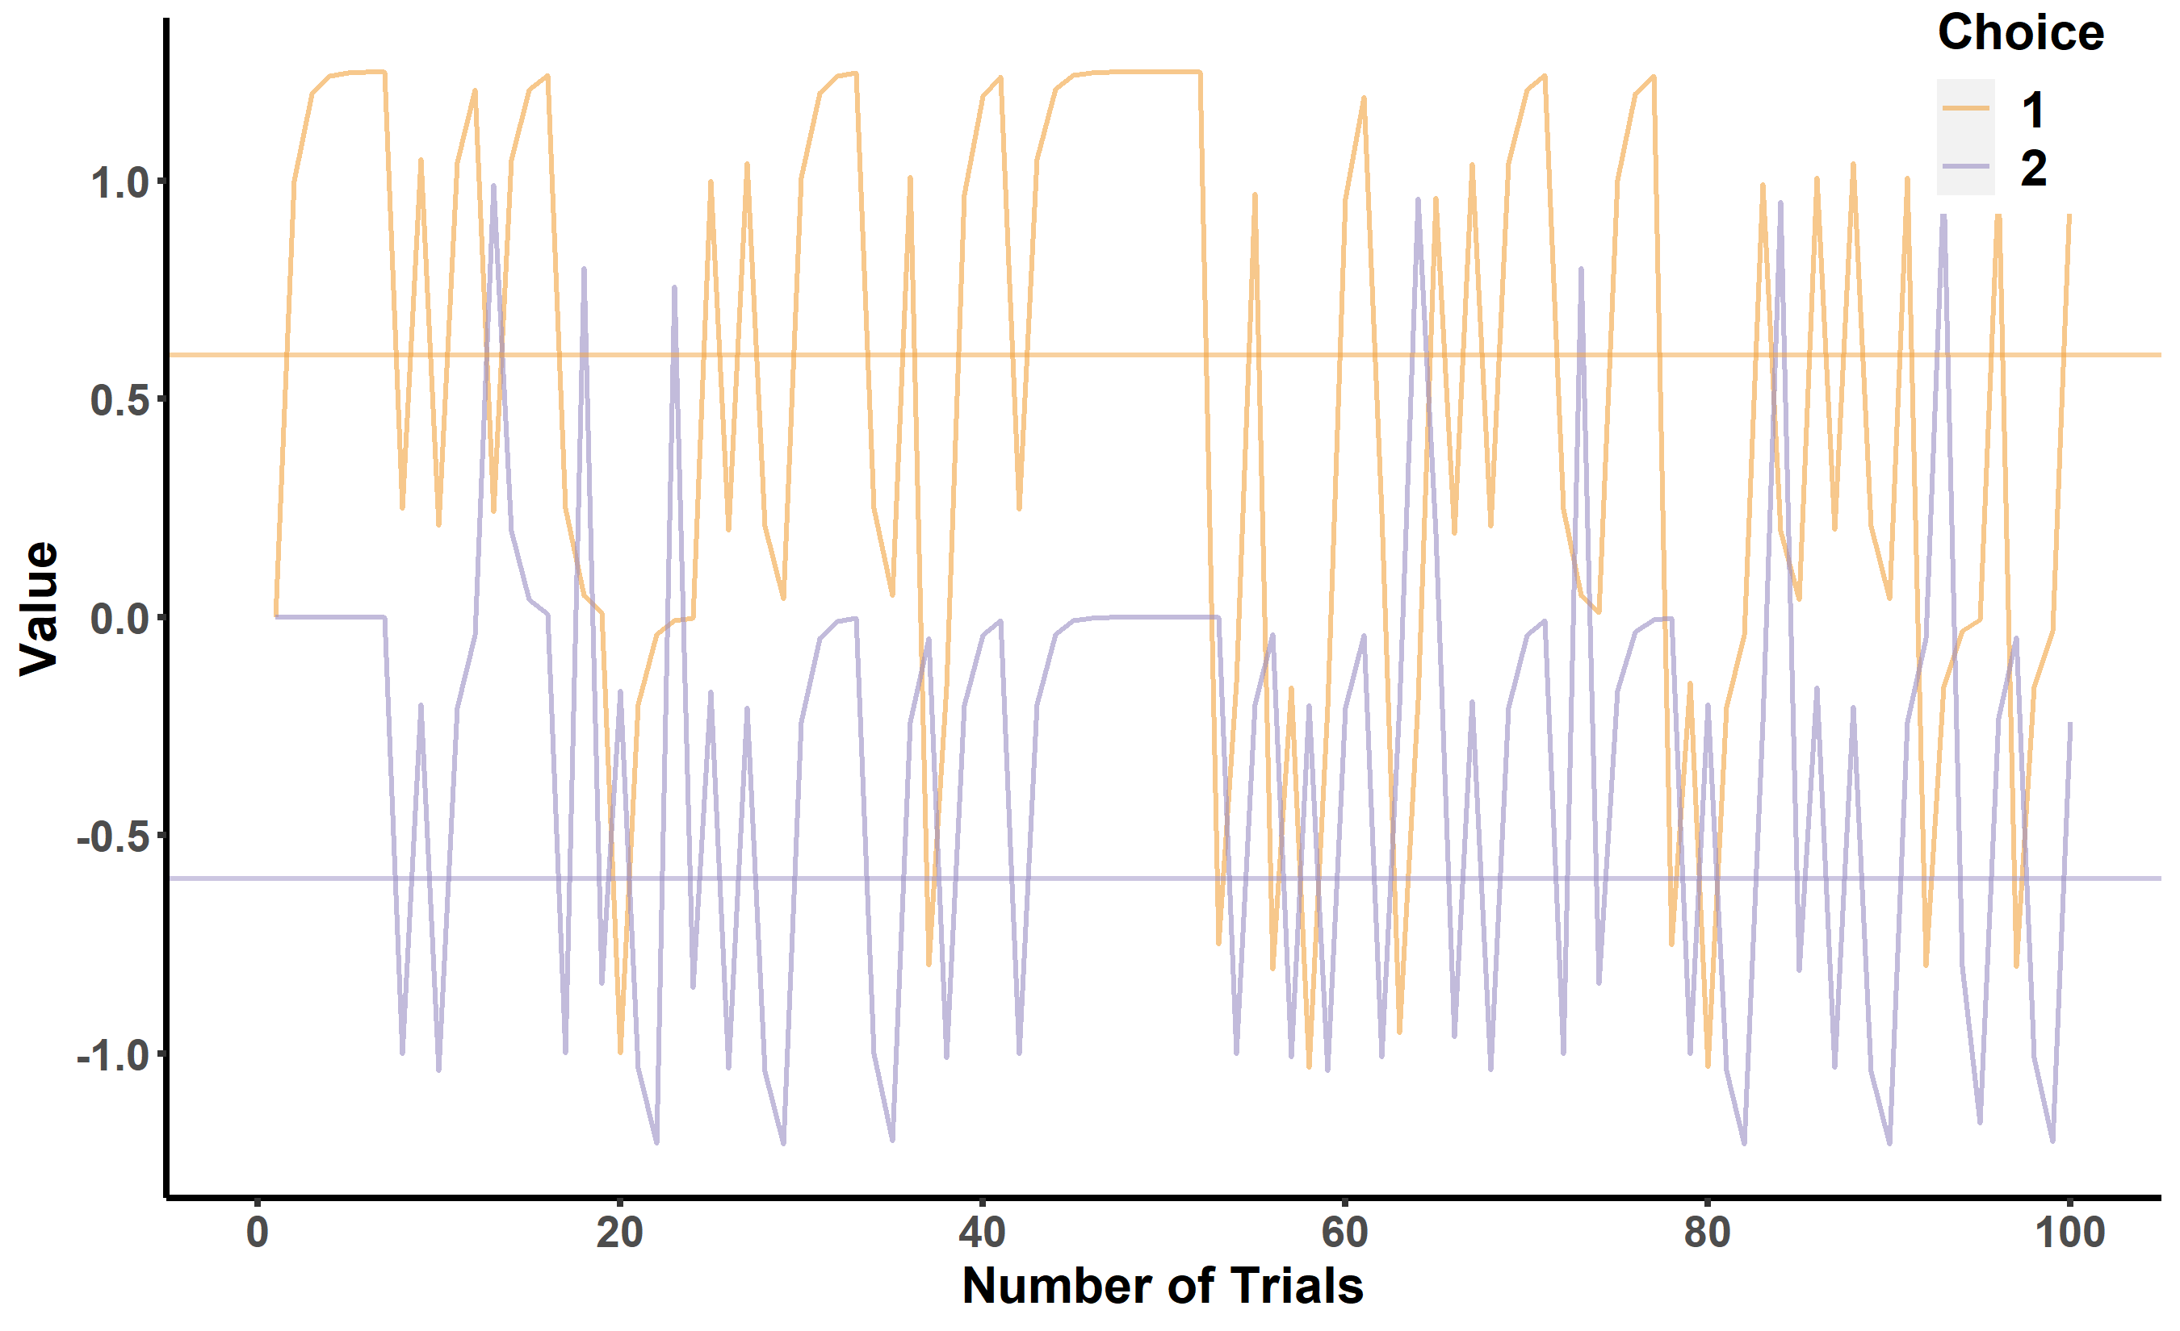
Results(decay)

Slide 23
Interactive Demo(decay)

Slide 24
Exploitation Bias
A
B
Reward=100 or 10
P(r=100)=0.8
P’(r=100)=0.2

Slide 25
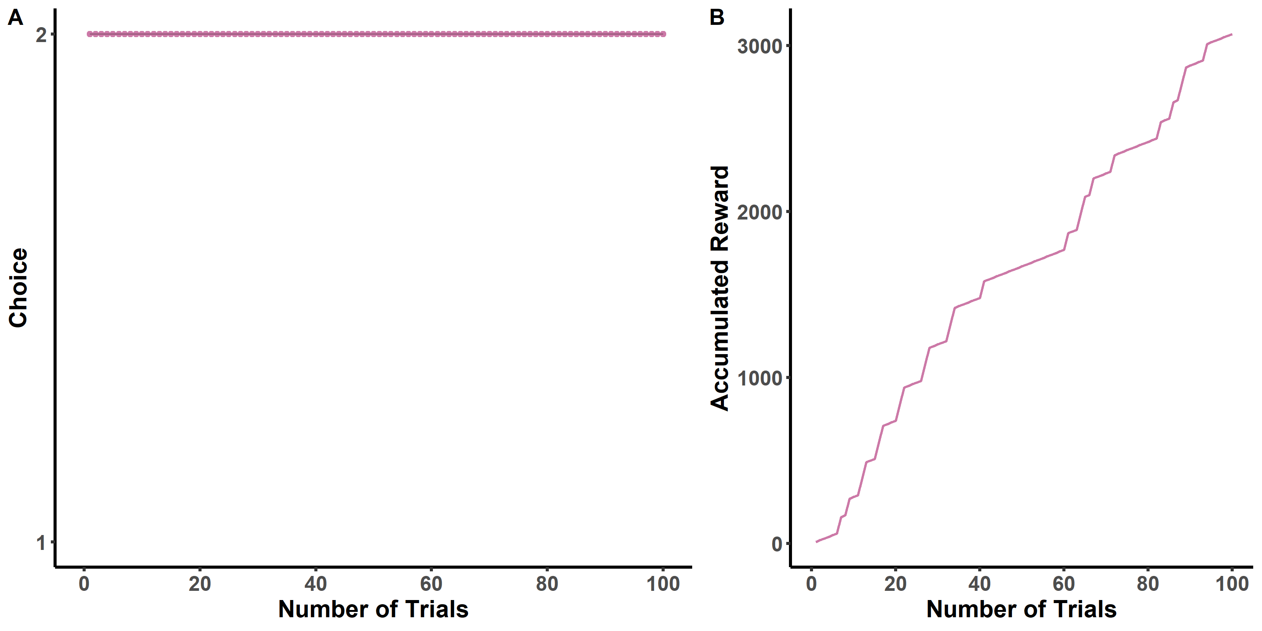
Exploitation Bias

Slide 26
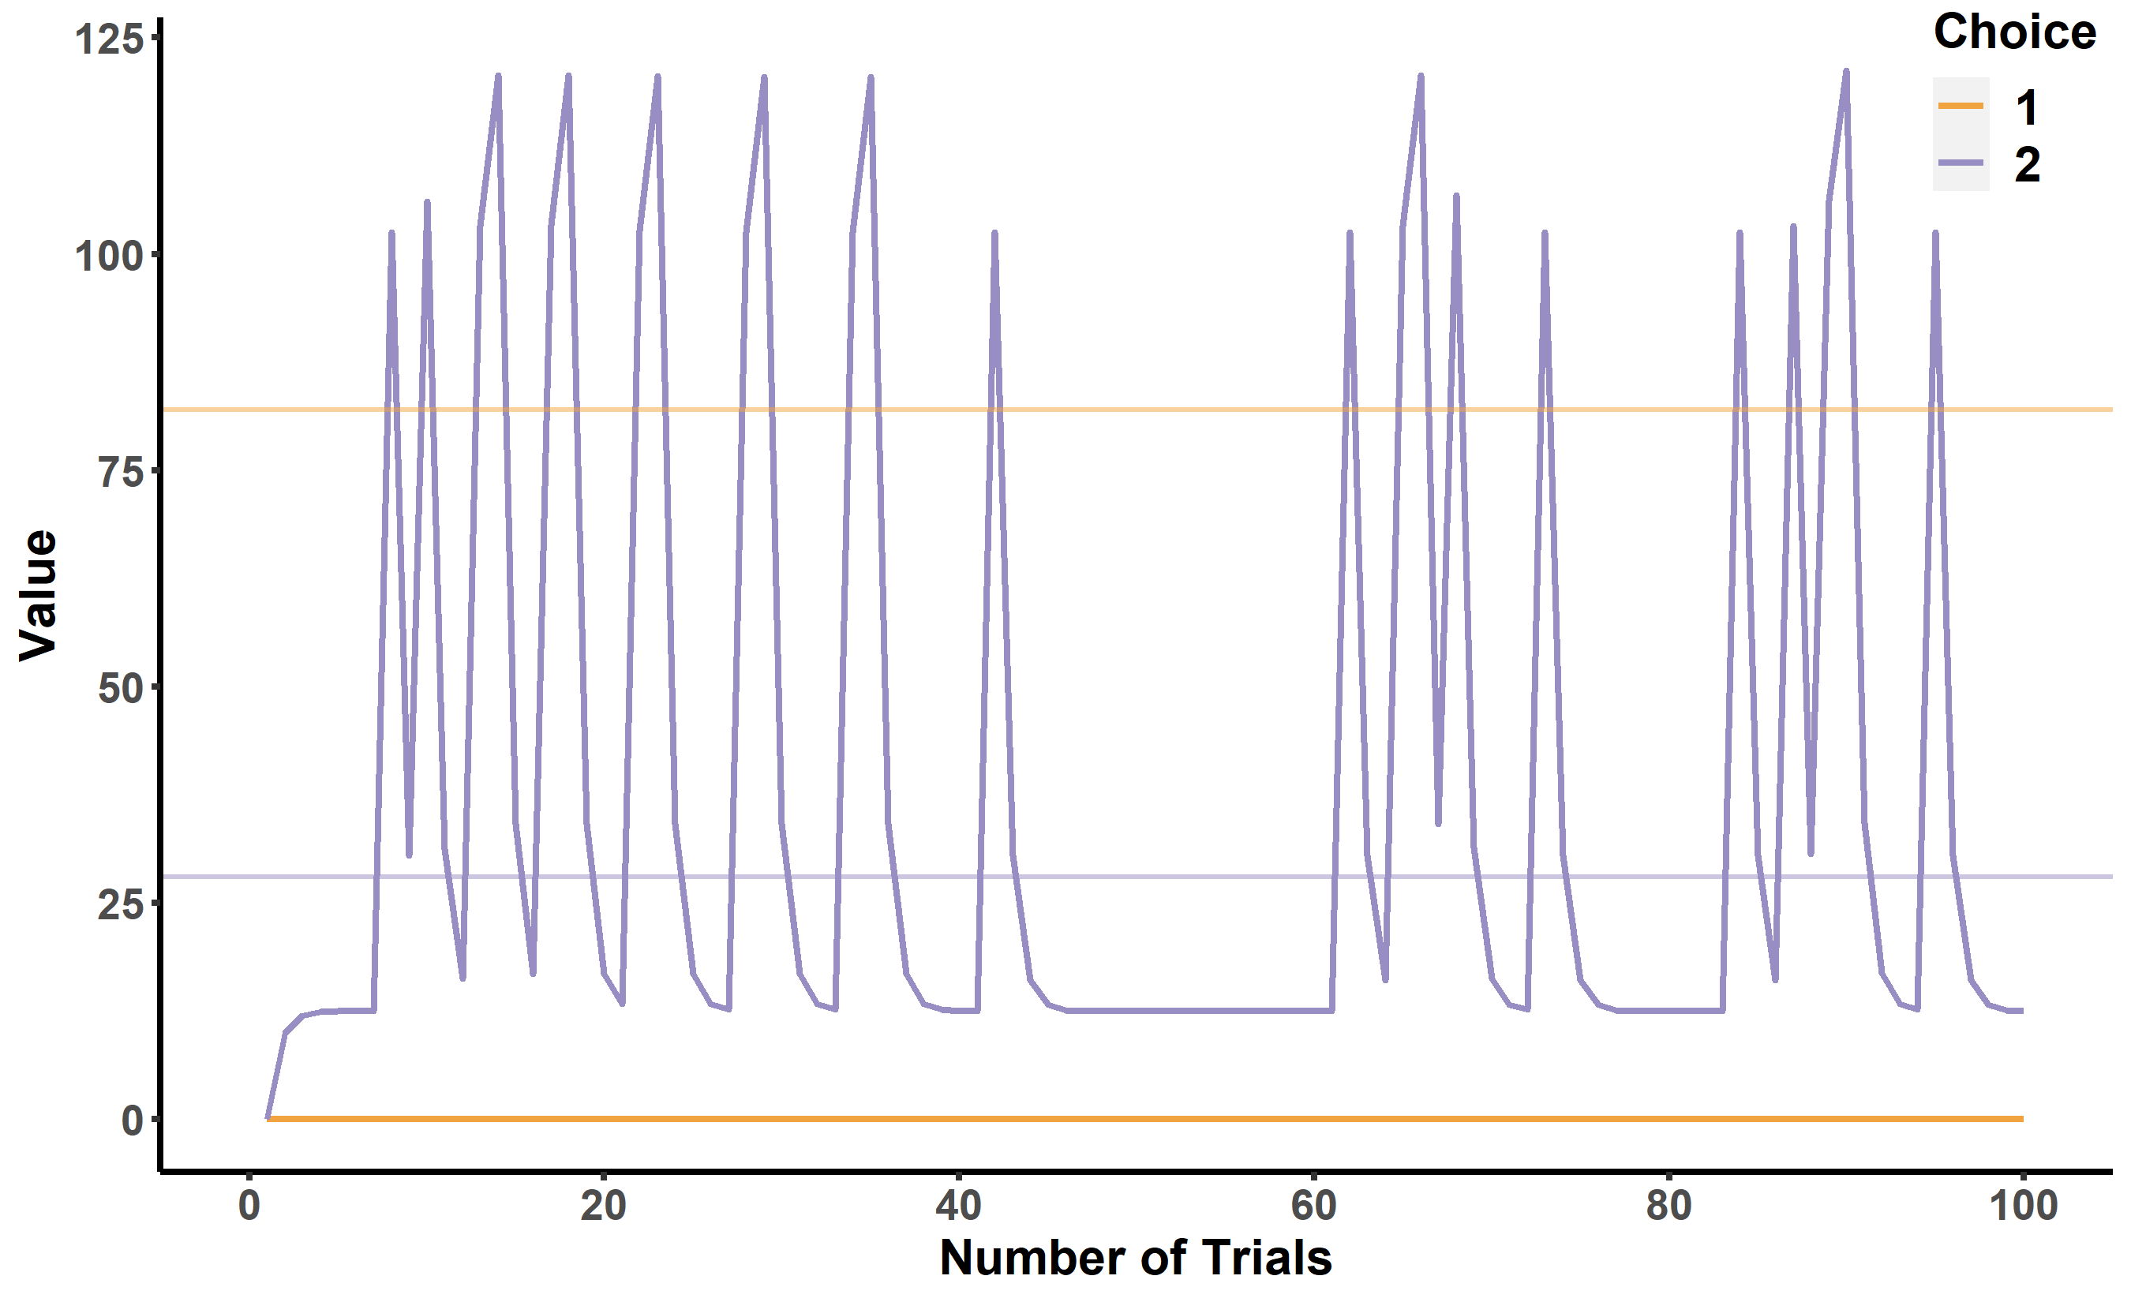
Exploitation Bias

Slide 27
Multi-armed bandit task
A
B
C
D
Rewards generated by normal distribution

Slide 28



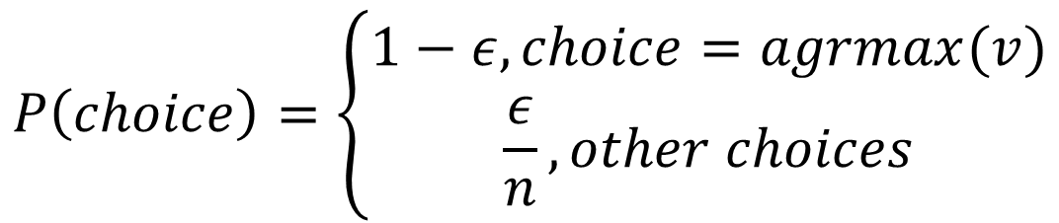
Exploitation vs Exploration
Epsilon-greedy:
$$PE=R−v_{i,t}$$
$$v_{i,t+1}=v_{i,t}+α∗PE$$
$$P\left(choice\right)=\left\{\begin{aligned}1−ε, choice=agrmax(v) \\ \frac{ε}{n}, other choices\end{aligned}\right.$$
$$ε:exploration weight$$
Other Recommendations:
Gershman, S.J. (2019). Uncertainty and exploration. Decision, 6, 277-286.
R.Lingeul. (2019) Sequential Exploration… Plos Computational Biology

Slide 29
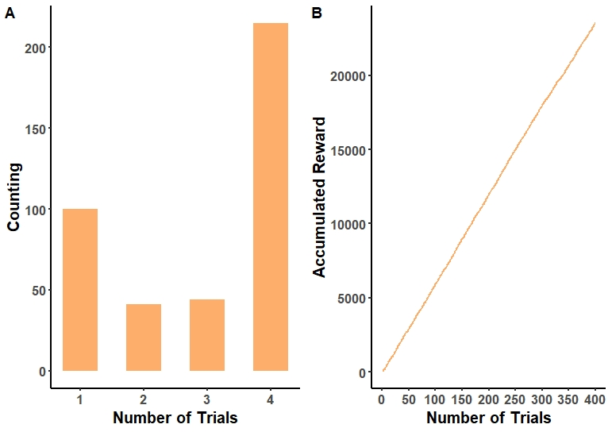
Result(ep-greedy)

Slide 30
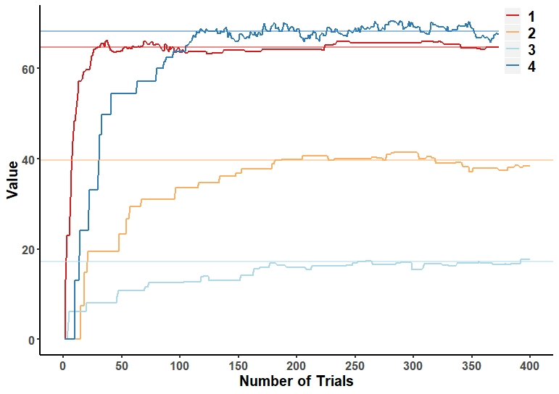
Result(ep-greedy)

Slide 31
Interactive Demo(ep-greedy)

Slide 32
Short Summary
Common Reinforcement Learning Models:
Rescorla-Wagner Model (delta rule)
Decay model (decay rule)
Epsilon-greedy model(exploration)
There are a lot of RL model that have not been covered……
TD learning
Fictitious update
Dynamic learning(adaptive learning rate)
Stochastic learning…
What do we learn? Why do we need to learn?

Slide 33
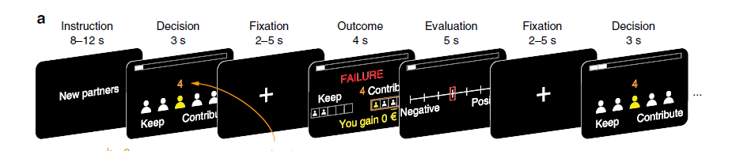

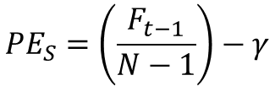
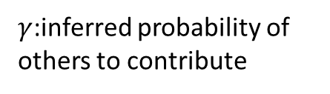
Extensions
Adaptive Social Learning
$γ$:inferred probability of others to contribute
$$γ=γ+f\left(α+θ∗PE_{R}\right)∗PE_{S}$$
$$PE_{S}=\left(\frac{F_{t−1}}{N−1}\right)−γ$$
S. Park, et. al 2019 Nature Communication

Slide 34
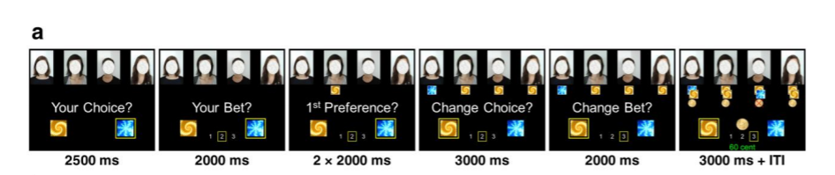

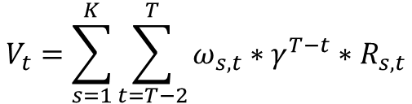



Extensions
$$V_{self}:$$
$V_{i,t}=V_{i,t−1}+α∗({R−V}_{i,t−1}$)
$$V_{i^{′},t}=V_{i^{′},t−1}+α∗(−R−V_{i^{′},t−1})$$
$$V_{other}:$$
$$V_{t}=\sum_{s=1}^{K}{\sum_{t=T−2}^{T}{ω_{s,t}∗γ^{T−t}∗R_{s,t}}}$$
Lei Zhang, Jan P. Gläscher, 2020. Science Advances

Slide 35
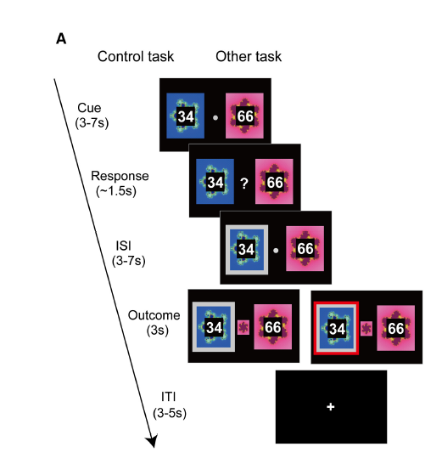
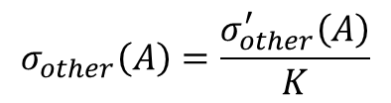



Extensions
$$V_{self}:V(A)=V(A)+α∗(r−V\left(A\right))$$
$$V_{other}:$$
$$V_{other}\left(A\right)=V_{other}\left(A\right)+α_{sRPE}∗δ_{other}\left(A\right)+α_{sAPE}∗σ_{other}(A)$$
$$δ_{other}\left(A\right)=r_{other}−V_{other}(A)$$
Reward prediction error
$$σ_{other}^{′}=I_{A}\left(A\right)−p_{other}\left(A\right)=1−p_{other}(A)$$
Action prediction error
$$σ_{other}\left(A\right)=\frac{σ_{other}^{′}\left(A\right)}{K}$$
Action-transformed value prediction error
$$K=R_{other}\left(A\right)∗p_{other}\left(A\right)∗p_{other}(B)$$
Shinsuke Suzuki, et.al 2012, Neuron

Slide 36
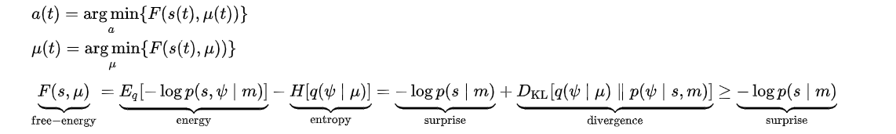
What to learn? Why learn?
Expectations:
Value
Q
Predictions
Hidden variables
Feedback:
Reward
Observed actions
Responses
Other external information
Prediction Error
Belief
Real-world Hidden States
Free energy principle: systems minimizes a free energy function of their internal states, which entail beliefs about hidden states in their environment.
Friston, Karl; Kilner, James; Harrison, Lee (2006). "A free energy principle for the brain" (PDF). Journal of Physiology-Paris. Elsevier BV. 100 (1–3): 70–87.

Slide 37
KF-Bayesian RL model
A
B
C
D
Reward generated by normal distribution
They might be volatile!

Slide 38
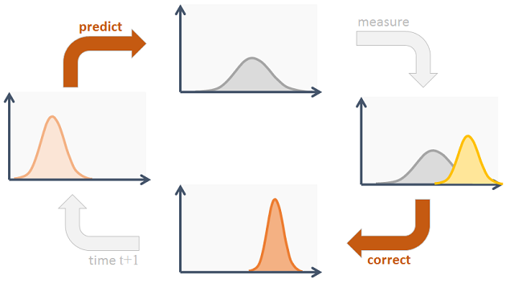
Kalman Filter
linear quadratic estimation (LQE)
NeuroMatch: Linear Dynamcis(W2D2)
G. Welch, G. Bishop, An introduction to Kalman Filter

Slide 39

Kalman Filter Bayesian RL
$m_{j,0}=u_{0}, v_{j,o}={σ_{0}}^{2}$
$u_{j}\left(t\right)\sim Normal\left(m_{j}\left(t\right),v_{j}\left(t\right)\right)$
$v_{j}\left(t\right)=v_{j}\left(t−1\right)\text{+}{σ_{u}}^{2}$
$k_{j}\left(t\right)=\left\{\begin{aligned}\frac{v_{j}\left(t\right)}{v_{j}\left(t\right)+{σ_{ε}}^{2}} if c=j \\ 0 otherwise\end{aligned}\right.$
$m_{j}\left(t\right)=m_{j}\left(t\right)+k_{j}\left(t\right)∗\left(R−m_{j}\left(t\right)\right)$
$v_{j}\left(t\right)=\left(1−k_{j}\left(t\right)\right)∗v_{j}\left(t\right)$
Speekenbrink, et.al 2015

Slide 40
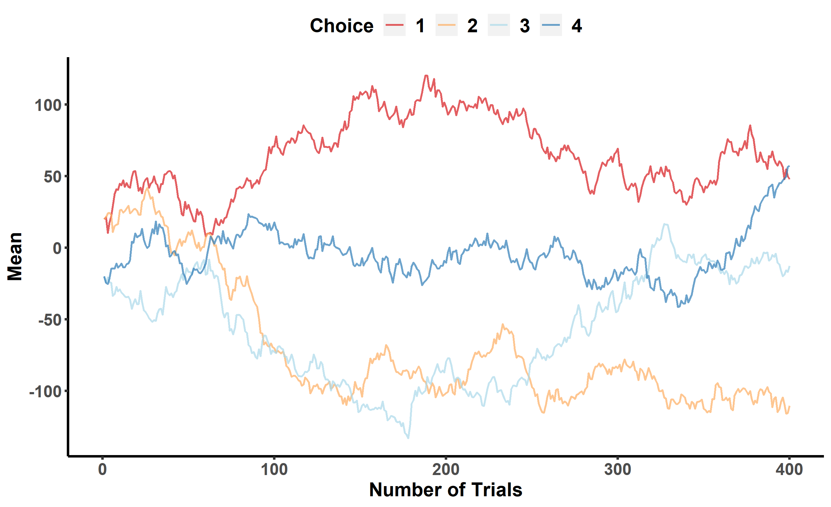
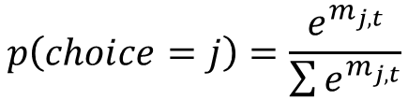
Softmax Rule
$$p\left(choice=j\right)=\frac{e^{m_{j,t}}}{\sum{e^{m_{j,t}}}}$$

Slide 41
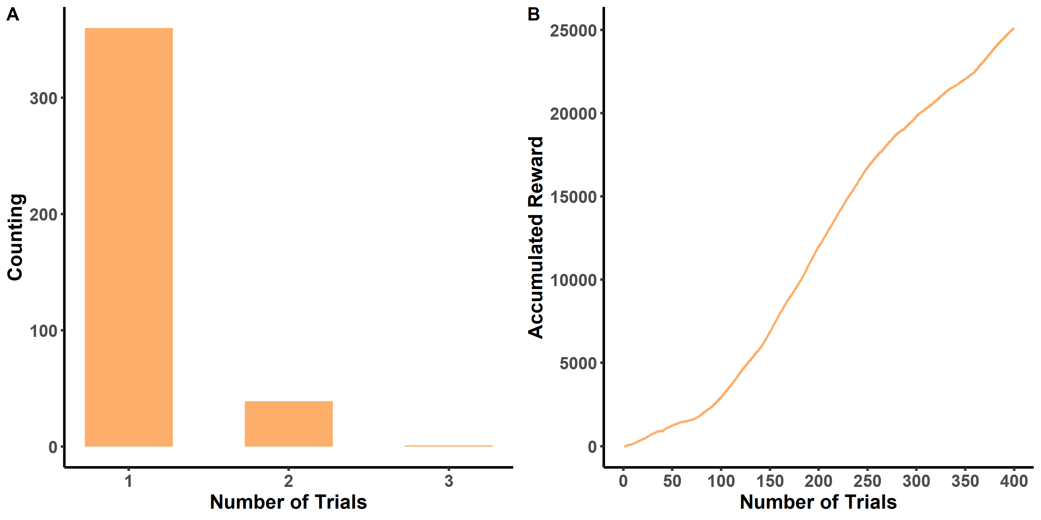
Softmax Rule

Slide 42
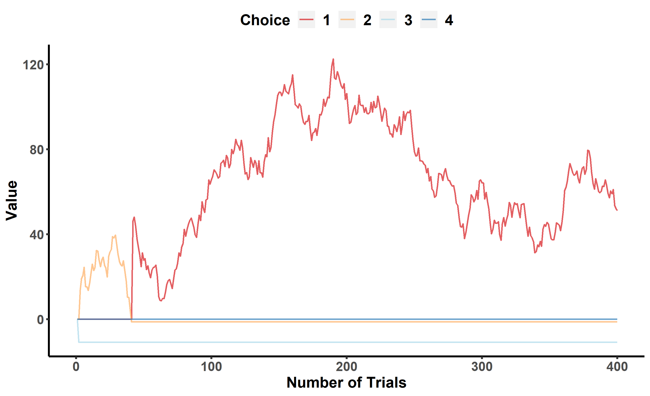
Softmax Rule

Slide 43
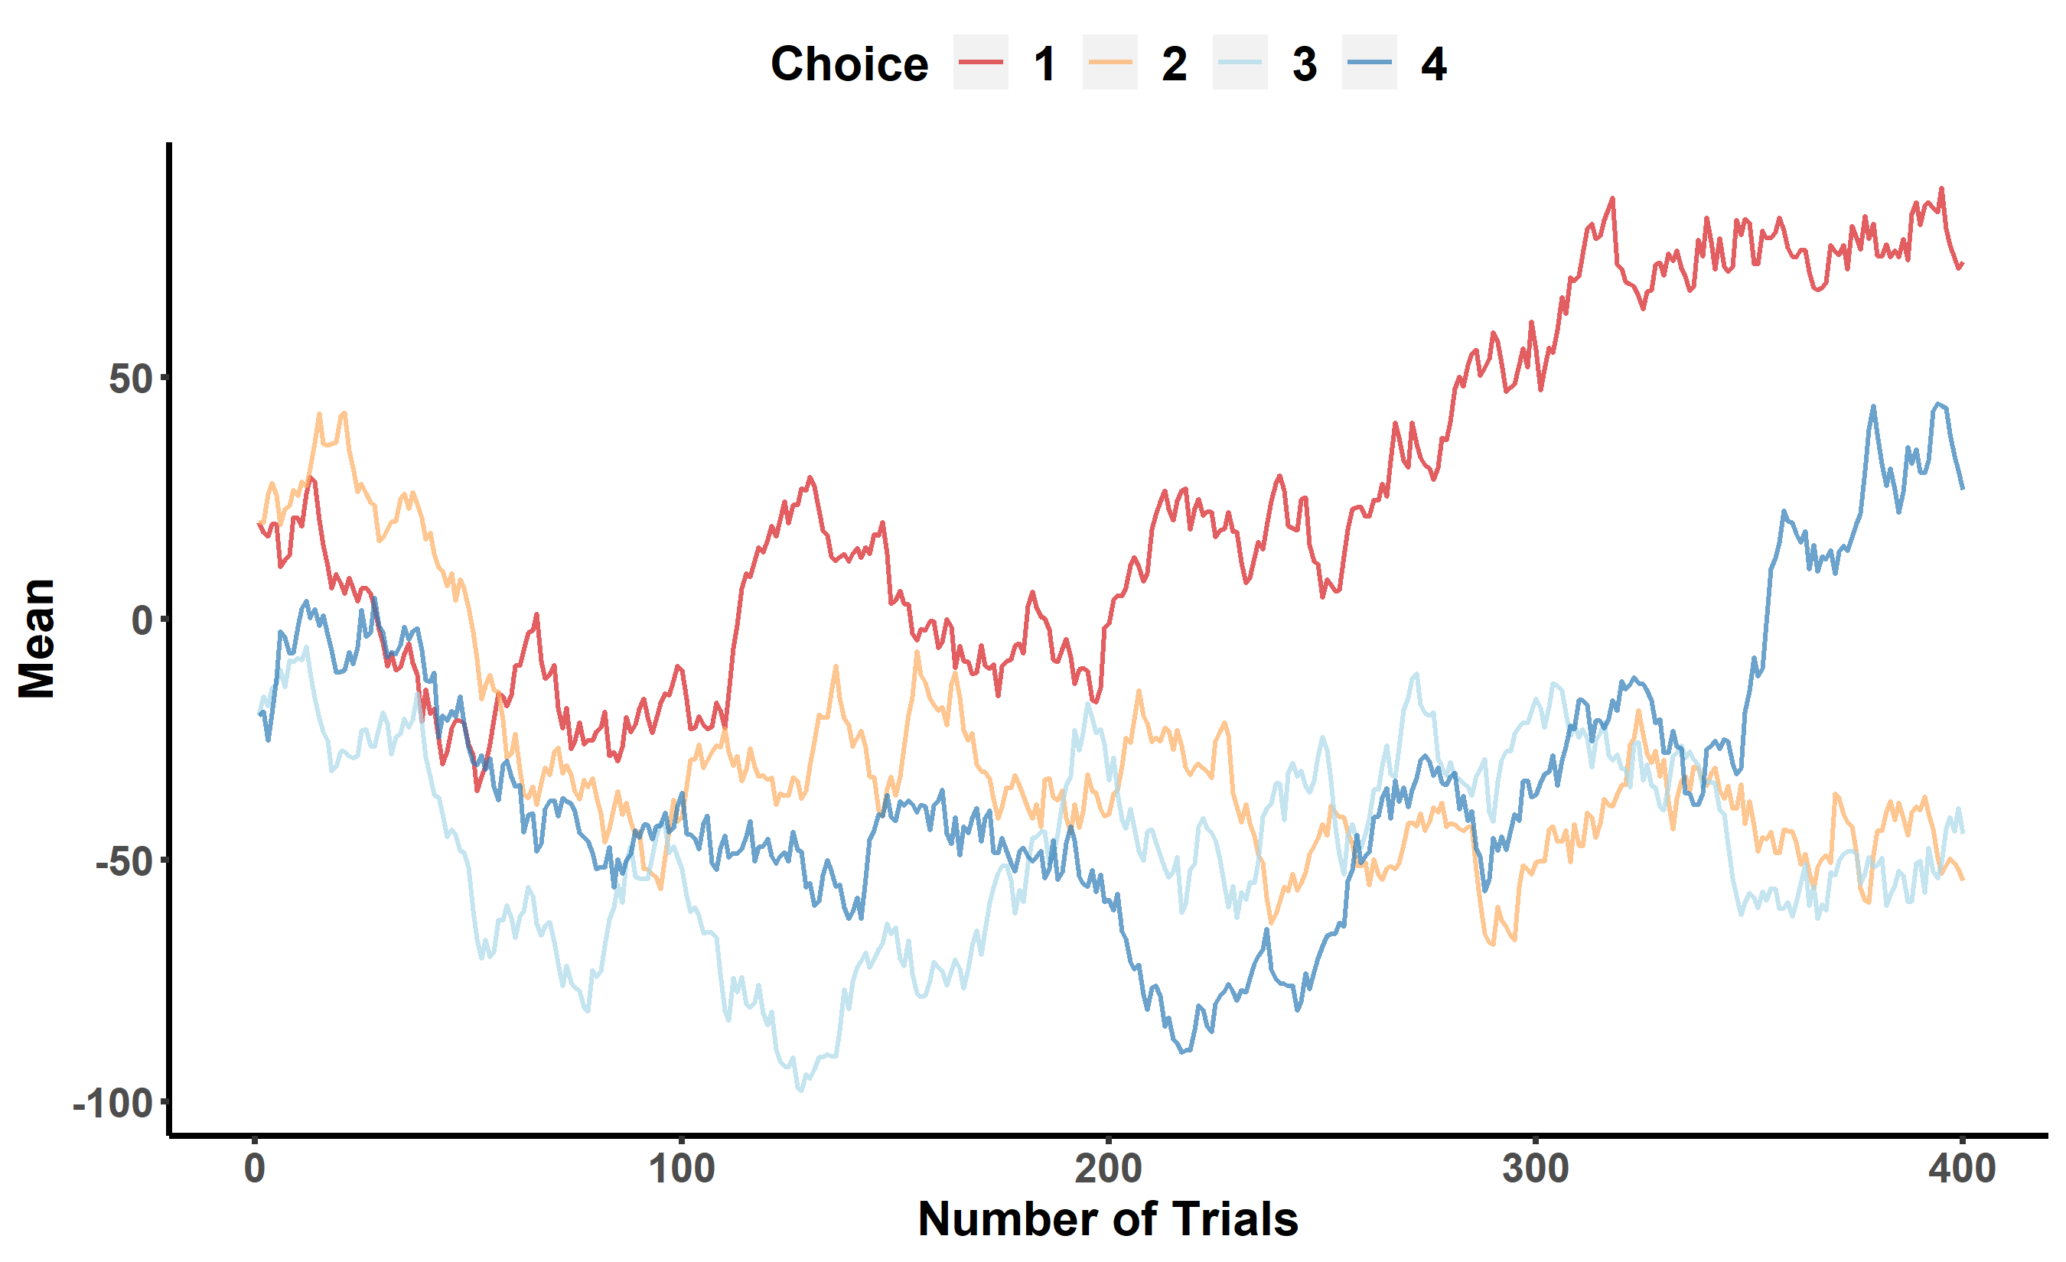

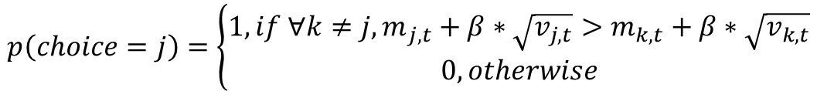
Upper Confidence Boundary(UCB)
$$p\left(choice=j\right)=\left\{\begin{aligned}1, if{ ∀k≠j, m}_{j,t}+β∗\sqrt{v_{j,t}}>m_{k,t}+β∗\sqrt{v_{k,t}} \\ 0, otherwise\end{aligned}\right.$$
$β$:confidence

Slide 44
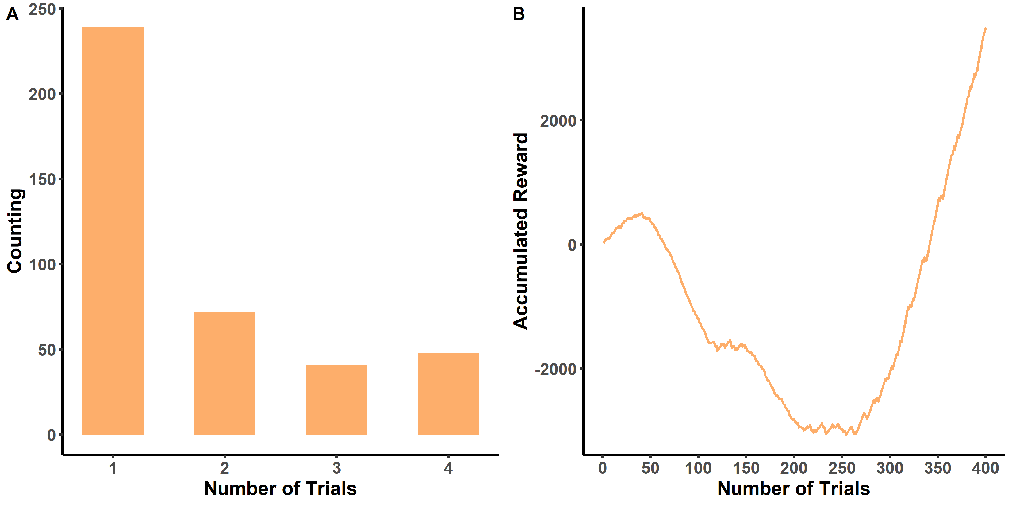
Result(UCB)

Slide 45
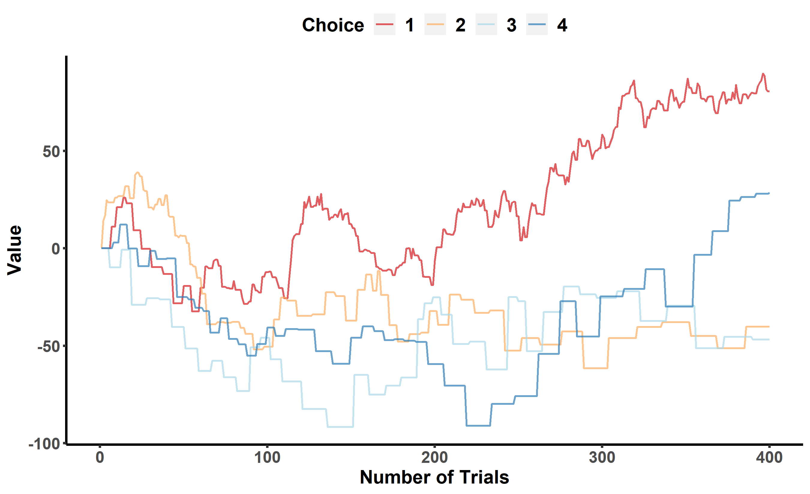
Result(UCB)

Slide 46
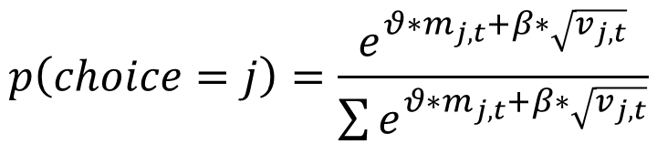
Interactive Demo(Softmax-version UCB)
$$p\left(choice=j\right)=\frac{e^{θ∗m_{j,t}+β∗\sqrt{v_{j,t}}}}{\sum{e^{θ∗m_{j,t}+β∗\sqrt{v_{j,t}}}}}$$

Slide 47



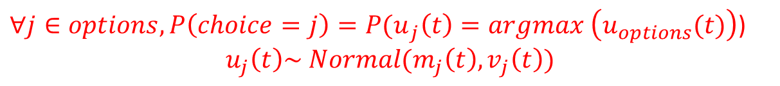



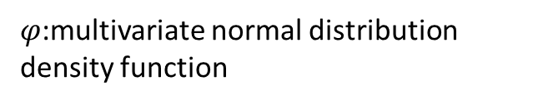
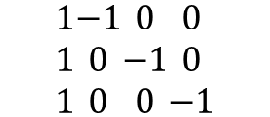
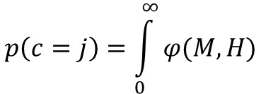
Thompson Sampling
$∀j∈options, {P\left(choice=j\right)=P(u}_{j}\left(t\right)=argmax \left(u_{options}(t)\right)$)
$$u_{j}\left(t\right)\sim Normal(m_{j}\left(t\right),v_{j}\left(t\right))$$
For each option $j$:
Build up a pair-wise matrix $A(i−1∗i)$:
$$\begin{matrix}1 \\ 1 \\ 1\end{matrix}\begin{matrix}−1 \\ 0 \\ 0\end{matrix}\begin{matrix}0 \\ −1 \\ 0\end{matrix}\begin{matrix}0 \\ 0 \\ −1\end{matrix}$$
$$A=$$
Calculate paired mean vector M:
$$M=A∗m$$
m: mean vector containing all options
Calculate paired covariance matrix H:
$$H=A∗diag\left(σ\right)∗A′$$
$σ$: standard deviation of all options
Calculate Probability:
$$p\left(c=j\right)=\int_{0}^{∞}{φ(M,H)}$$
$φ$:multivariate normal distribution density function
R:pmvnorm
Matlab: mvncdf

Slide 48
Result(TS)

Slide 49
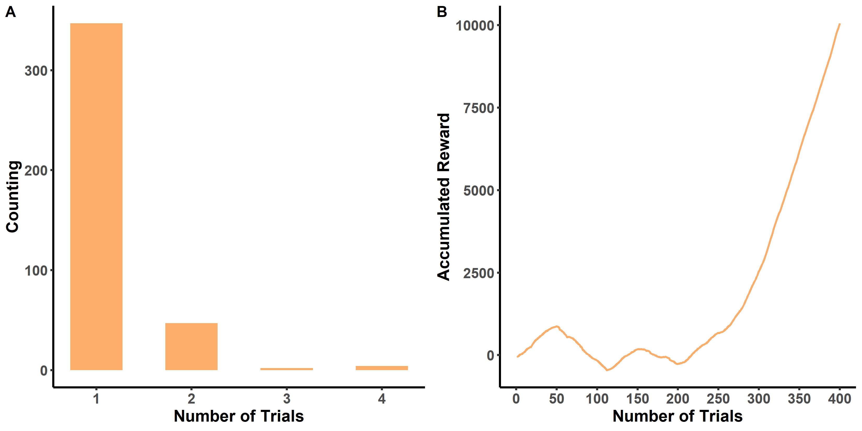
Result(TS)

Slide 50
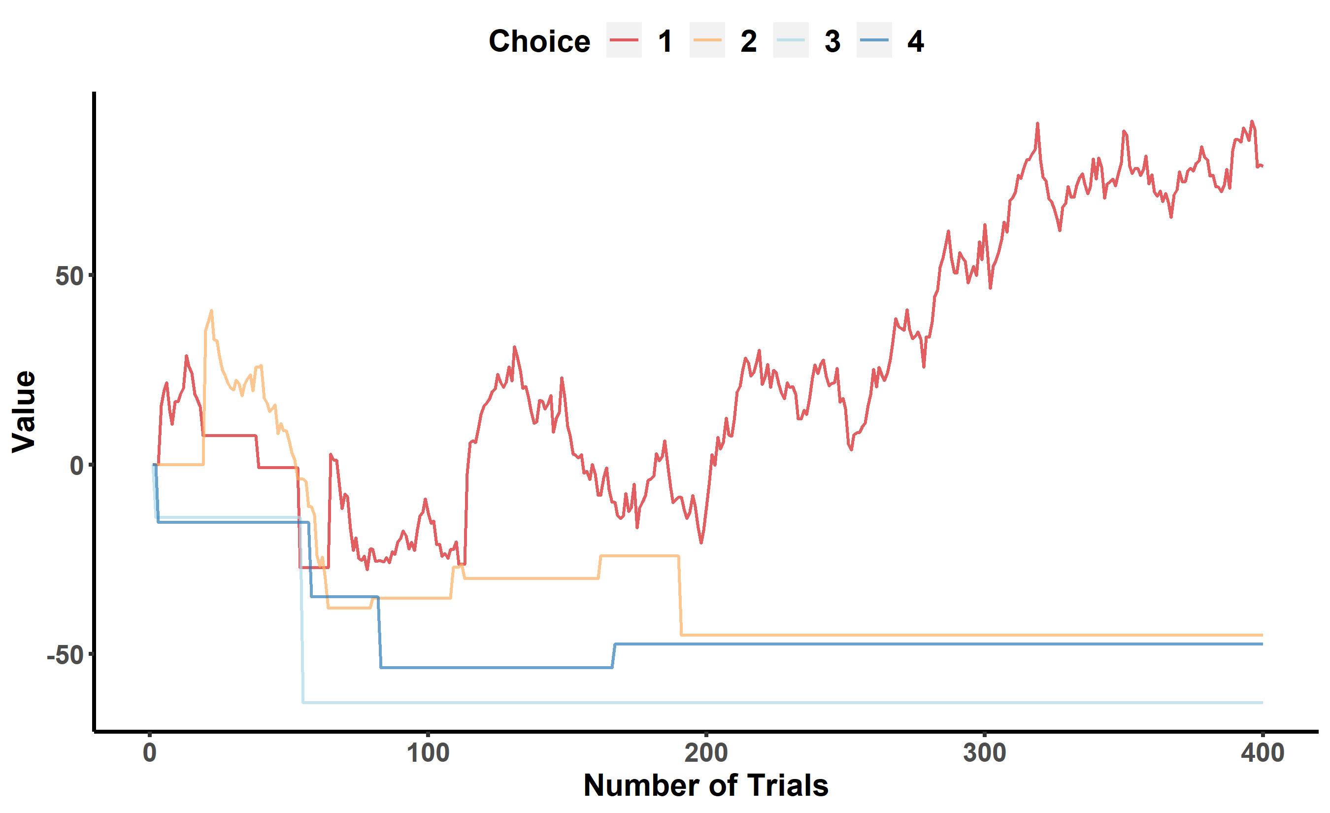
Result(TS)

Slide 51
Possible Questions
Which model should I use?
It depends on your research questions.
Which is the best model?
All models are wrong. But you can still compare them.
Should I use an existing model or create a new one?
It depends. But try to simulate first.
What can be different in RL when it’s applied in social learning?
We should consider social interactions into RL framework.
More questions? Discussion time!
L Zhang, L Lengersdorff, N Mikus, J Gläscher, C Lamm - 2019

Slide 52
Summary
Models:
WSLS
Rescorla Wagner Model
Decay Rule
Epsilon-greedy Model(exploration)
Practice:
How to Simulate?
Define the environment
Define an agent
Define the environment response
Set and run simulation process
Analyze and visualize simulated data
Extensions:
Some social RL research
Karl Friston FEP
Kalman Filter Based Bayesian RL Model
Reinforcement Learning is far more than we reach today!
NeuroMtach: W2D5 intro&outro

Slide 53
Acknowledgement
Thank Xuefei Pan for help of optimizing codes and materials, Chunlei Lu organizing modeling club!
All materials, codes, reference paper have been updated to OSF. Exercises for interested individuals!

